Slide 2
CONTENTS
 | SELECTED PROJECTS | 3
 | METRICS CALCULATED | 4
 | DIFFICULTIES FACED | 5
 | JACOCO…??? | 6
 | MUTATION TESTING : METRIC 3 | 7
 | RELATIVE CHURNED CODE MEASURE : METRIC 5 | 8
 | DEFECT DENSITY: METRIC 6 | 9
 | RELATED WORK | 10
 | CORRELATION BETWEEN METRIC | 11
 | REFERENCES | 17

Slide 3



SELECTED PROJECTS
01
Apache Common Collections
(4.2) [132k].
02
Apache Common Configuration
(2.4) [847k].
03
Apache Common Math
(3.6.1) [186k]
04
Apache Common Lang
(3.8.1) [80k]
05
Apache Common IO
(2.6) [35k].
Notes:
Maven : Build and Dependency management tool

Slide 4

METRICS CALCULATED
Code Coverage
Post release bug density
Branch Coverage
Test Suite Effectiveness (Mutation Testing)
Maintenance Effort as Churned Code / LOC
Mccabe Complexity

Slide 5





DIFFICULTIES FACED
GETTING PROJECTS READY ON MACHINE
The Compilation was the project was bit tedious and took us 4 days to get all project compiled.
We faced Several Maven issues due to version conflicts and eclipse version issue.
We used Eclipse LUNA and dev version for maven connectors.[2][3]
Once set up was done, next steps were quite simple to gather data.
Adding dependency in pom.xml
Run goal or build maven

Slide 6
JACOCO…???
WHAT IS JACOCO
Because It is used in number of researches and also in industry to continually monitor code coverage.
JaCoCo is a free code coverage library for Java, which has been created by the EclEmma team based on the lessons learned from using and integration existing libraries for many years. [3]
WHY JACOCO
Jacoco Provides reports in both HTML and CSV.
It measures code coverage (statement, instruction and branch coverage) and also calculates Mccabe Complexity and WMC for the methods and classes respectively.
Notes:
Because It is used in number of researchs and also in industry to continually monitor code coverage.

Slide 7
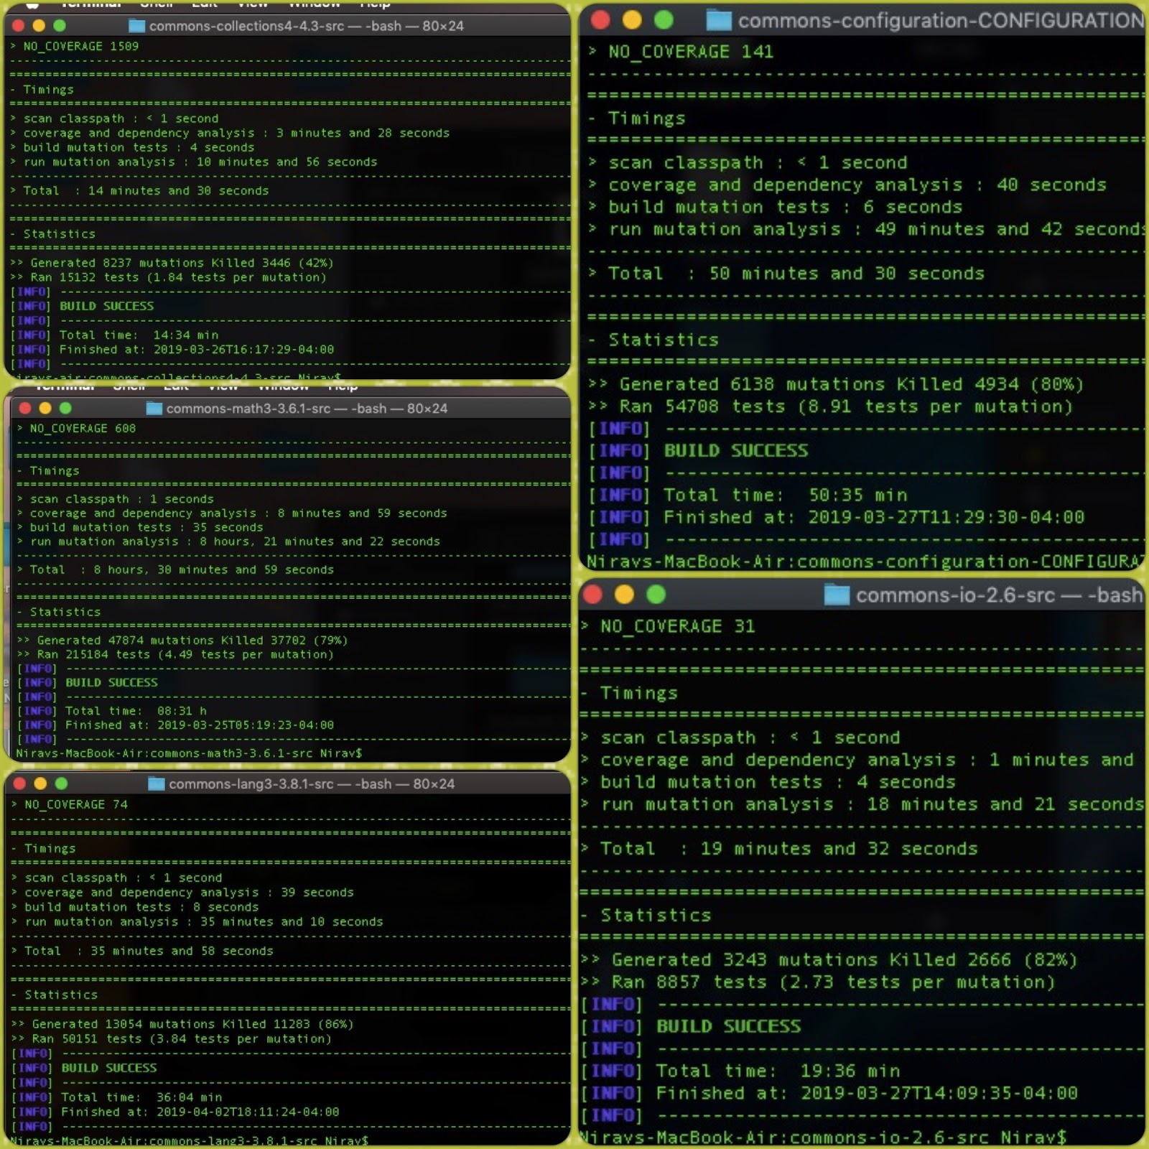
MUTATION TESTING : METRIC 3
Mutation Testing : Metric 3
We used PI Test[6] to perform mutation testing on selected projects considering it community support and robustness.
Steps :
Adding dependency in pom.xml
Executing goal
Notes:
Why Robust? It is used in many researches.
ReadMe File : Github

Slide 8
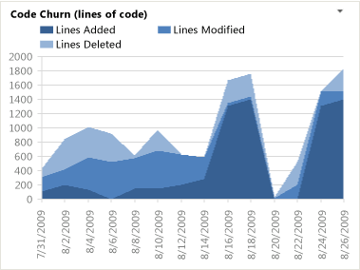
RELATIVE CHURNED CODE MEASURE : METRIC 5
Relative Churned Code Measure : Metric 5
We Measured Maintenance Effort as :
Relative Churned Code = Churned LOC / Total LOC
Where,
Churned LOC = (added + changed) LOC[4]

Slide 9
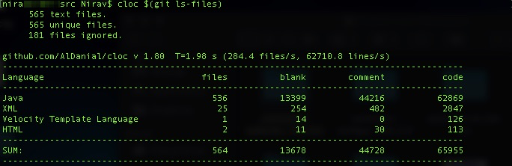
DEFECT DENSITY: METRIC 6
Defect Density: Metric 6
Post Release Defect Density = Defect count(No of bugs)/size of the release(KLOC)
How did we calculate it?
Calculating No of Genuine Bugs from Issue Tracker(JIRA in our case)
Dividing it by LOC
How did we calculate LOC?
We found very accurate and handy tool to calculate rather than directly calculating LOC from every file that resides in source folder. Some of the file may not be actually related to program, such as author list and pull request template.
That’s why we chose CLOC[5]:
Notes:
Very advance tool, It can remove comment from the code - md5 checksum
Trusting any open source project and using it in research is not a good option, so we manually tested it before using and claiming our results

Slide 10
RELATED WORK
(2019). St.cs.uni-saarland.de. Retrieved 2 April 2019, from https://www.st.cs.uni-saarland.de/edu/recommendation systems/papers/ICSE05Churn.pdf
This Paper uses code churn to predict the defect density in software systems. Code churn is a measure of the amount of code change taking place within a software unit over time. It is easily extracted from a system’s change history, as recorded automatically by a version control system.
W. E. Wong, J. R. Horgan, S. London, and A. P. Mathur. Effect of test set size and block coverage on the fault detection effectiveness. In Proceedings of 1994 IEEE International Symposium on Software Reliability Engineering, pages 230–238, Nov 1994
This is a Paper written by W. E. Wong, J. R. Horgan, S. London and A. P. Mathur [20] where they compare the correlation between fault detection effectiveness and block coverage, and fault detection effectiveness and the size of a test set. They describe block coverage as a sequence of consecutive statements or expressions that include no branches except at the end, which means that if one element of the code is executed, all are
Investigating the Correlation between Mutation Score and Coverage Score - IEEE Conference Publication. (2019). Ieeexplore.ieee.org. Retrieved 2 April 2019, from https://ieeexplore.ieee.org/document/6527442
This experimental test results support our hypothesis of strong positive correlation between coverage and mutation scores. In fact, it has exceeded our hypothesis of +0.5, further proving the effectiveness of mutation analysis as a tool to augment test cases.
Pavneet Singh Kochhar, David Lo, Julia Lawall, Nachiappan Nagappan. Code Coverage and Postrelease Defects: A Large-Scale Study on Open Source Projects. IEEE Transactions on Reliability, Institute of Electrical and Electronics Engineers, 2017, 66 (4).
This Paper States that : At the project level, code coverage has an insignificant correlation with the number of bugs as well as with the number of bugs per LOC and the number of bugs per complexity. Coverage/complexity has a moderate negative correlation with the number of bugs and an insignificant correlation with the number of bugs/LOC. By categorizing projects based on size and complexity, we observe an insignificant correlation between coverage and other metrics.
Notes:
For correlation between metric 5 and 6, It got .883 , we also got aroung 0.9, Positive
They show that there is a correlation between block coverage and fault detection effectiveness, that is higher than a correlation between fault detection effectiveness and the size of a test set. (Metric 1,2 to 3)
Coverage and Mutation Testing (Metric 1,2 to 3)
Coverage and DD, Insignificant correlation

Slide 11
CORRELATION BETWEEN METRIC

Slide 12
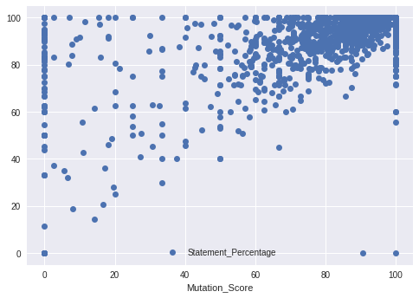
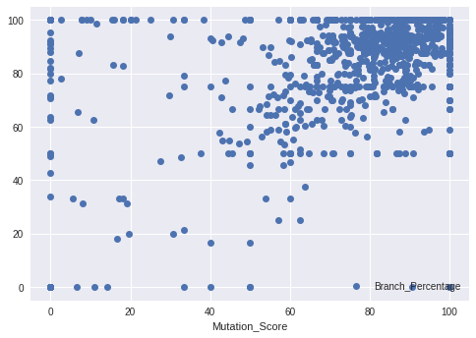
CORRELATION BETWEEN CODE COVERAGE AND MUTATION SCORE
Correlation between Statement Coverage and Mutation Score
p = 0.61 (Strong Positive Correlation)
Correlation between Branch Coverage and Mutation Score
p = 0.45 (Medium Positive Correlation)
Notes:
Why we chose Spearman over pearson? Because software data are not normalized generally, Also known as grade correlation.
Our hypothesis

Slide 13
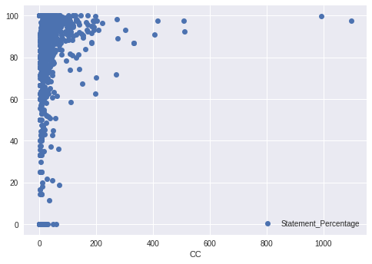
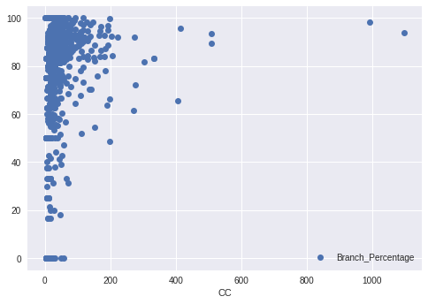
CORRELATION BETWEEN COVERAGE AND MCCABE COMPLEXITY
Correlation between Statement Coverage and Mccabe Complexity
p = -0.35 (Medium Negative Correlation)
Correlation between Branch Coverage and Mccabe Complexity
p = -0.21 (Negative Weak Correlation)
Notes:
We found 1 paper,
Persson, S. (2015). The correlation between code coverage, cyclomatic complexity and fault frequency. DIVA. Retrieved 3 April 2019, from http://www.diva-portal.org/smash/record.jsf?pid=diva2%3A826710&dswid=-4763
We have found that there is little to no correlation between metrics for code coverage and
software faults. We have also found that there is no correlation what so ever between
cyclomatic complexity and software faults Therefore we can conclude there is no correlation or
very correlation between code coverage and code complexity.

Slide 14
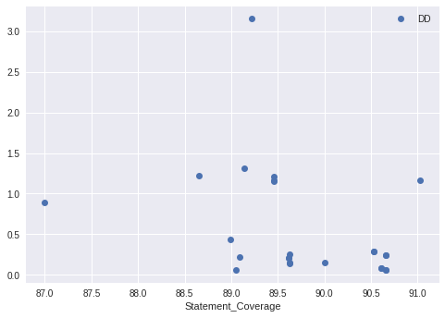
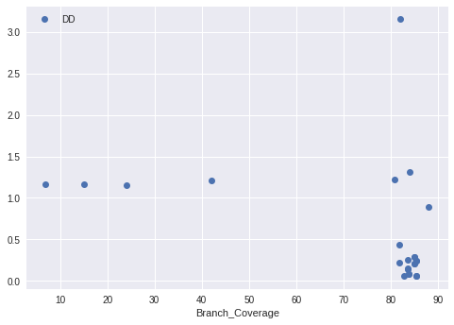
CORRELATION BETWEEN COVERAGE AND DEFECT DENSITY
Correlation between Statement Coverage and Defect Density
p = -0.431776 (Medium Negative Correlation)
Correlation between Branch Coverage and Defect Density
p = -0.431289 (Negative Weak Correlation)
Notes:
Negative Correlation

Slide 15
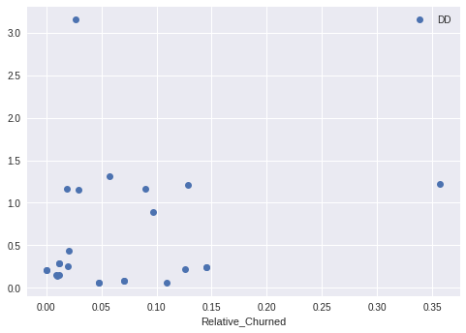
CORRELATION BETWEEN RELATIVE CHURNED CODE AND DEFECT DENSITY
Correlation between Relative Churned Code and Defect Density
Correlation between Relative Churned Code and Defect Density
p = 0.18 (Insignificant Correlation)
However for the correlation between each project, we found following data:
Project | Spearman Rank
Collection | -0.1
Configuration | -0.3
IO | 0
Lang | 0.6
Math | -0.1

Slide 16
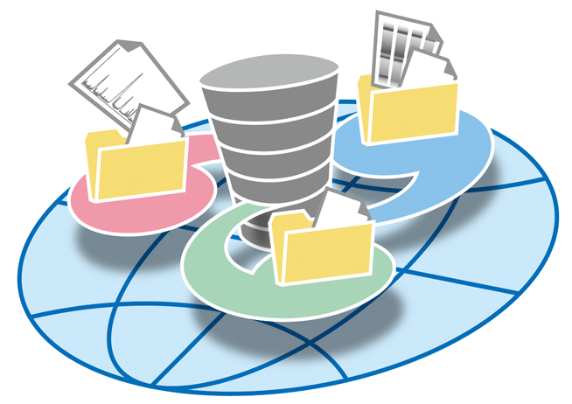

REPOSITORY AND DATA ANALYSIS PROCEDURE

Slide 17

REFERENCES
Wiedmann, J., Wiedmann, J., & profile, V. (2011). The mess that is m2e connectors. Grumpyapache.blogspot.com. Retrieved 1 April 2019, from http://grumpyapache.blogspot.com/2011/08/mess-that-is-m2e-connectors.html
objectledge/maven-extensions. (2019). GitHub. Retrieved 1 April 2019, from https://github.com/objectledge/maven-extensions
EclEmma - JaCoCo Java Code Coverage Library. (2019). Eclemma.org. Retrieved 1 April 2019, from https://www.eclemma.org/jacoco
Use of relative code churn measures to predict system defect density - IEEE Conference Publication. (2019). Ieeexplore.ieee.org. Retrieved 1 April 2019, from https://ieeexplore.ieee.org/document/1553571
CLOC -- Count Lines of Code. (2019). Cloc.sourceforge.net. Retrieved 1 April 2019, from http://cloc.sourceforge.net/
PIT Mutation Testing. (2019). Pitest.org. Retrieved 2 March 2019, from http://pitest.org/

Slide 18
THANK YOU

